Slide 1


What is self awarenesS
INTRO
Def--→ It’s all about conscious knowledge of One’s own character & Feelings
TYPES
Rajat Khandelwal

Slide 2

Want to Increase Your Self-Awareness? Ask For Feedback
If you want to enhance self-awareness,you need to understand how others see you.
It’s like a shortcut for understanding your habits, quirks, and behaviors.
Asking for regular constructive feedback cuts through any self-deceit or you might hold.
“Feedback from one person is a perspective; feedback from two people is a pattern; but feedback from three or more people is likely to be as close to a fact as you can get.”

Slide 3
Recognise Your Strengths And Weakness
This allows us to sustain our strengths and work on our weaknesses.
Knowing our weaknesses is as important as knowing your strengths.
When one recognizes their strengths, they should nurture them and make use of them.

Slide 4
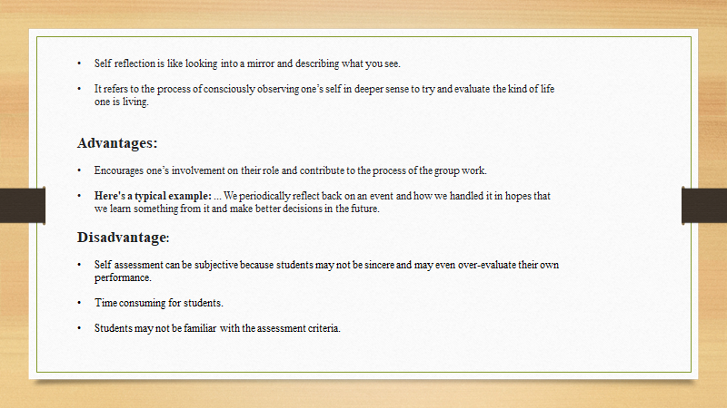
SELF REFLECTION

Slide 5
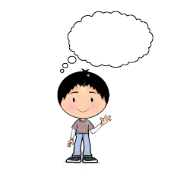
Monitor your Self Talk
Is there actual evidence for what I'm thinking?
What would I say if a friend were in a similar situation?
Is there a more positive way of looking at this?
Am I keeping everything in perspective?
Can I do anything to change what I'm feeling bad about?

Slide 6
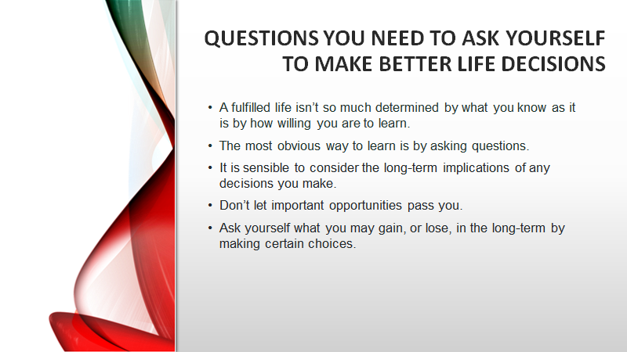

Slide 7
Mindfulness Meditation helps in self awareness
Reduce feeling of depression
Can control your anger
Solve your confusion
Increase energy
Control your thoughts
When our mind in calm and tension free it helps us for self evaluation and self awareness
Jaidev gulia

Slide 8

Conclusion
Self-awareness is being honest with yourself about who you are.
Who Am I ?

